Slide 1
Capstone 2: Happiness
By Miranda Mazur

Slide 2

What contributes to a country's happiness from the past 5 years?
Based on 6 Elements
Economy GDP
Family/Social Support
Health (Life Expectancy)
Trust in Government
Freedom
Generosity
It’s important to look into what makes countries happy. Happiness can lead to better quality of life for everyone

Slide 3
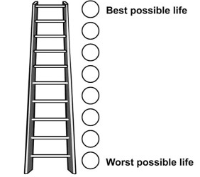
Background of Survey
Conducted by the Gallup World Survey since 2012
Survey is based on the Cantril Self-Anchoring Striving Scale
All 6 elements add up to the happiness score which ranks it among other countries
Cantril Ladder. Source: ResearchGate

Slide 4
Overall Insight
Europe countries tend to have higher happiness scores compared to the rest of the world
Each country must score high in the different elements in order to be higher ranked
African countries tend to score the least

Slide 5
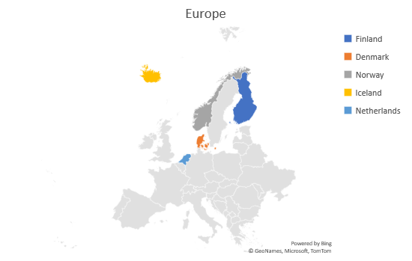
European countries are ranked the best based on there overall score
Except for Canada, The top ranked countries are north European
Rank | 2015 | 2016 | 2017 | 2018 | 2019
1 | Switzerland | Denmark | Norway | Finland | Finland
2 | Iceland | Switzerland | Denmark | Norway | Denmark
3 | Denmark | Iceland | Iceland | Denmark | Norway
4 | Norway | Norway | Switzerland | Iceland | Iceland
5 | Canada | Finland | Finland | Switzerland | Netherlands

Slide 6
The worst ranked countries tend to be from the Africa and Middle East Regions
Taking the bottom 5 countries from each year, the African region tends to rank bottom the most
Compared to the top 5 scored countries, there is a huge 15-16 point difference
Year | Worst | Best
2015 | 15.555 | 37.624
2016 | 16.121 | 37.447
2017 | 16.121 | 37.526
2018 | 15.9 | 37.763
2019 | 15.704 | 37.905

Slide 7
The United States overall happiness score has decreased by .23
The family element is the only one that constantly increased
Even though the score was the same in 2018 and 2019, the U.S was ranked worse in 2019

Slide 8
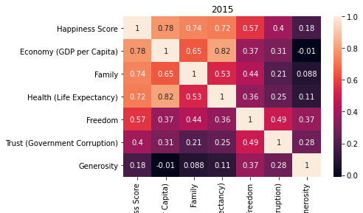
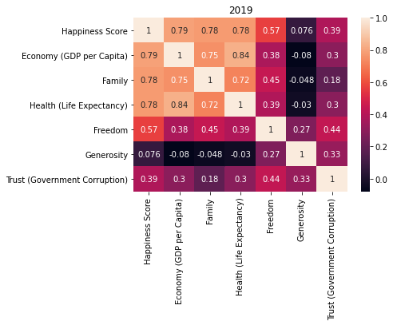
GDP, Family and then Life Expectancy are the most correlated to happiness score
From 2015 to 2019 GDP contributes the most but family and health have increased in the span of 5 years
Generosity and Trust in Government tend to contribute the least to the happiness score

Slide 9
Even though the Economy GDP element is the most correlated to happiness score, mid ranked countries claim the highest GDP score
Year | Country | GDP Score | Rank
2015 | Qatar | 1.69042 | 28
2016 | Qatar | 1.82427 | 36
2017 | Qatar | 1.8707657 | 35
2018 | United Arab Emirates | 2.096 | 20
2019 | Qatar | 1.684 | 29
A high GDP doesn’t necessarily mean a high happiness score
Qatar for every year except one has the highest GDP score. It was 2nd place in 2018
Qatar must rank lower in other elements thus decreasing its overall happiness rank and score

Slide 10
As of 2019, several Asian countries have the highest scored elements
Country | Region | Overall Rank | Element
Qatar | Middle East and Northern Africa | 29 | GDP
Luxembourg | Western Europe | 14 | GDP
Singapore | Southeastern Asia | 34 | GDP
Iceland | Western Europe | 4 | Social Support
Finland | Western Europe | 1 | Social Support
Norway | Western Europe | 3 | Social Support
Singapore | Southeastern Asia | 34 | Healthy life expectancy
Hong Kong | Eastern Asia | 76 | Healthy life expectancy
Japan | Eastern Asia | 58 | Healthy life expectancy
Uzbekistan | Central and Eastern Europe | 41 | Freedom
Cambodia | Southeastern Asia | 109 | Freedom
Norway | Western Europe | 3 | Freedom
Myanmar | Southeastern Asia | 131 | Generosity
Indonesia | Southeastern Asia | 92 | Generosity
Haiti | Latin America and Caribbean | 147 | Generosity
Singapore | Southeastern Asia | 34 | Trust in Government
Rwanda | Sub-Saharan Africa | 152 | Trust in Government
Denmark | Western Europe | 2 | Trust in Government
Top 3 scores from each element suggests not one element influences the happiness score or rank
Even though the top ranked countries appear, they might not have the best element
The best ranked countries have social support as the highest influence
Generosity has the least influence

Slide 11
Living longer and having a healthy lifestyle does not necessarily mean happiness
Healthy Lifestyle is not the biggest factor in happiness
The best ranked country is 22
All of the top 3 heathiest countries for each year are from the East and South East Asian region

Slide 12
The average trust in government has gone down in the past 5 years
Even though it is a small decrease of .03, it can still impact a countries happiness rank
It can lead to a lower happiness score
It isn’t the most influential element

Slide 13
Summary: Can happiness really be measured?
Not one element drives a happiness score more than others
Much more goes into a country's happiness than these 6 elements
Can be used by government organizations to influence policy making
A suggestion of a new survey with more elements such as education and/or natural elements factor might more accurately reflect happiness

